Slide 1
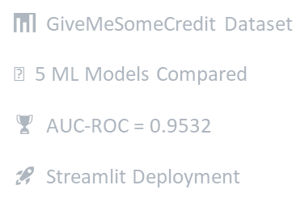
Credit Scoring
For Better decision Making
%
Done By:
Raed Alouani
Amira Farrah

Slide 2
BUT
Imagine walking into a bank and asking for a loan…
Within seconds, the system already knows your risk level — before a human even reviews your file
How do we make sure that decision is fast, fair, and accurate… when real-world data is messy, incomplete, and highly imbalanced?

Slide 3
This is exactly the challenge we tackled in our project:
Predicting credit default risk using machine learning

Slide 4
Context
Problem
Banks need to assess borrower risk before granting credit.
Manual evaluation is slow, inconsistent and error-prone.
An automated ML model provides fast, objective decisions.
Predict whether a borrower will default within 2 years.
Target: SeriousDlqin2yrs (0 = No default, 1 = Default)
Severe class imbalance: only 6.7% of defaults.
SOLUTION
EDA
And
Preprocessing
SMOTE (class balancing)
4 Baseline Models
GridSearchCV Optimization
Streamlit Deployment
COMMISSIONS
INTEREST RATE

Slide 5
1 Dataset & Exploratory Analysis

Slide 6
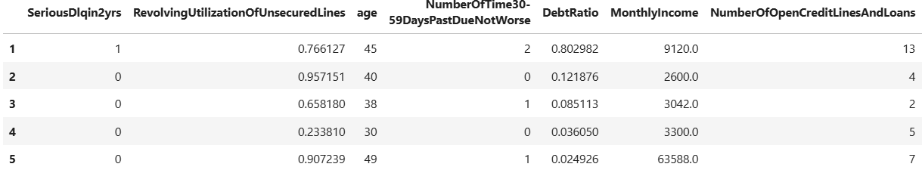
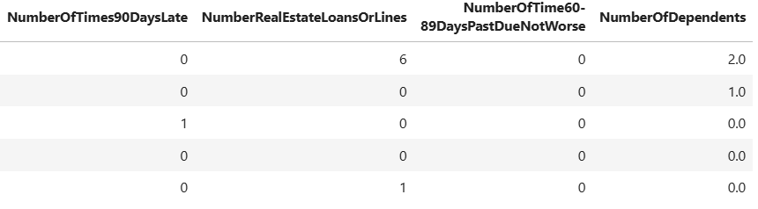
df.head()

Slide 7
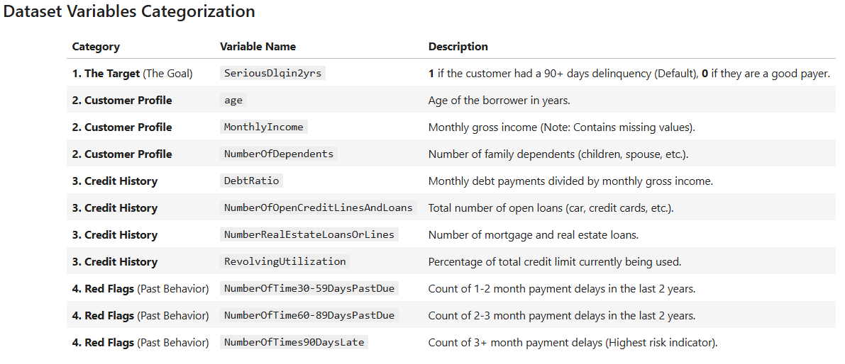

Slide 8
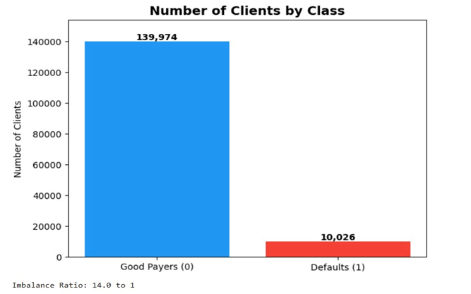
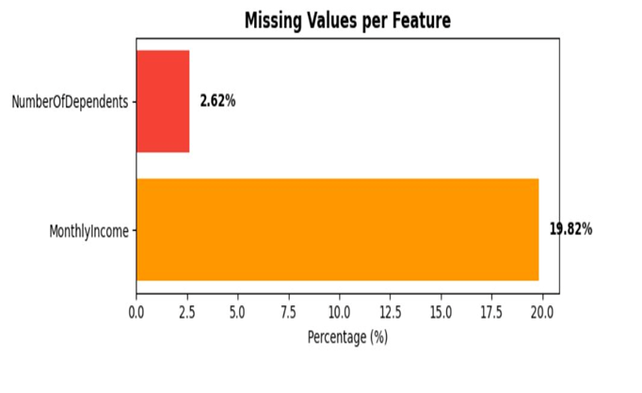


Slide 9
2 Data Preprocessing

Slide 10
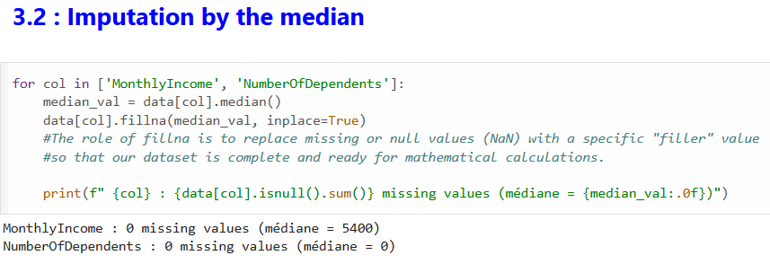
01 🔧 Median Imputation
MonthlyIncome → 19.82% missing
NumberOfDependents → 2.62% missing
Replaced by column median
→ Robust to outliers vs mean imputation

Slide 11
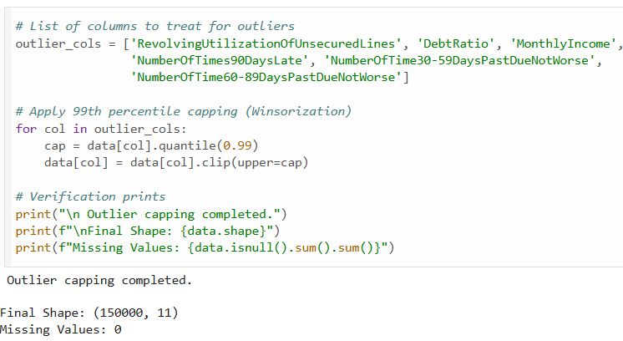
02 ✂️ Outlier Capping (Winsorization)
6 features treated for outliers
Cap at 99th percentile
Preserves distribution shape
→ Reduces extreme value impact

Slide 12
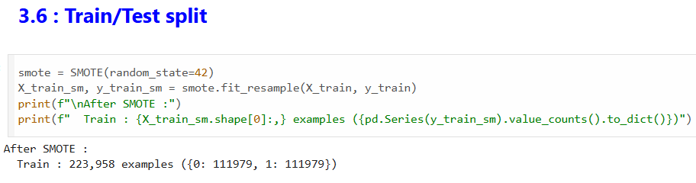
03 ⚖️ SMOTE — Class Balancing
Before: 111,979 vs 8,021 (14:1)
After: 111,979 vs 111,979 (1:1)
Synthetic minority oversampling
→ Prevents model bias toward class 0

Slide 13
3 Model Training & Comparison

Slide 14
MODELS
Logistic Regression
Random Forest
XGBoost
KNN
Linear baseline · Fast · Interpretable
Ensemble · Handles non-linearity
Gradient boosting · High performance
Distance-based · Non-parametric

Slide 15
Evaluation Metrics
AUC-ROC
F1-Score
Accuracy
Avg Precision
Primary metric — handles imbalance
Balance precision & recall
Overall correctness
Precision-Recall tradeoff

Slide 16
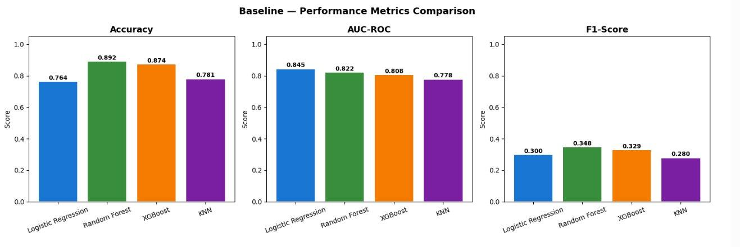
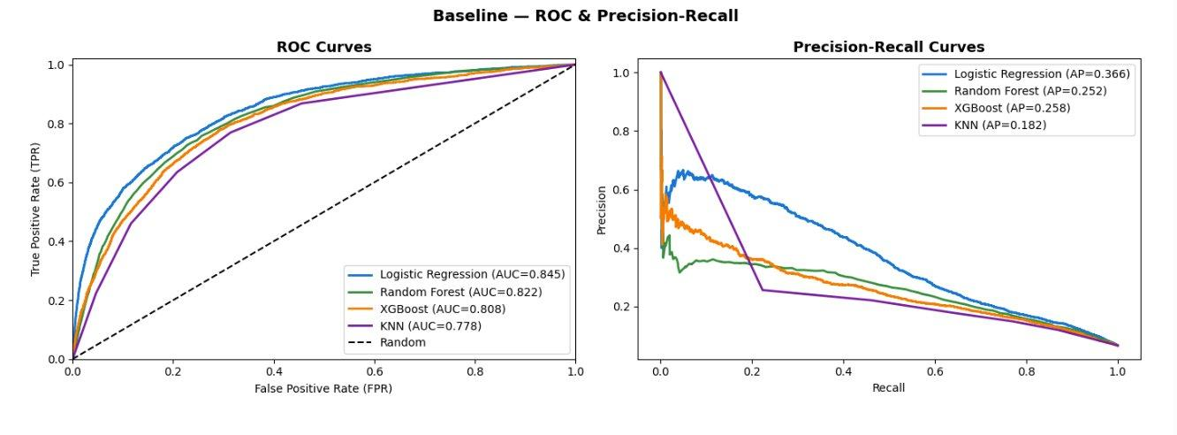

Slide 17
AFTER MODEL OPTIMIZATION
Model | AUC-ROC ↑ | F1-Score | Accuracy | Avg Precision
Logistic Regression ★ | 0.8451 | 0.3002 | 0.7641 | 0.3656
Random Forest | 0.8215 | 0.3484 | 0.8924 | 0.2524
XGBoost | 0.8083 | 0.3292 | 0.8742 | 0.2658
KNN | 0.7782 | 0.2797 | 0.7813 | 0.2109
XGBoost (Optimized) 🏆 | 0.9532
🏆 XGBoost Optimized → AUC = 0.9532

Slide 18
DASHBOARD

Slide 19
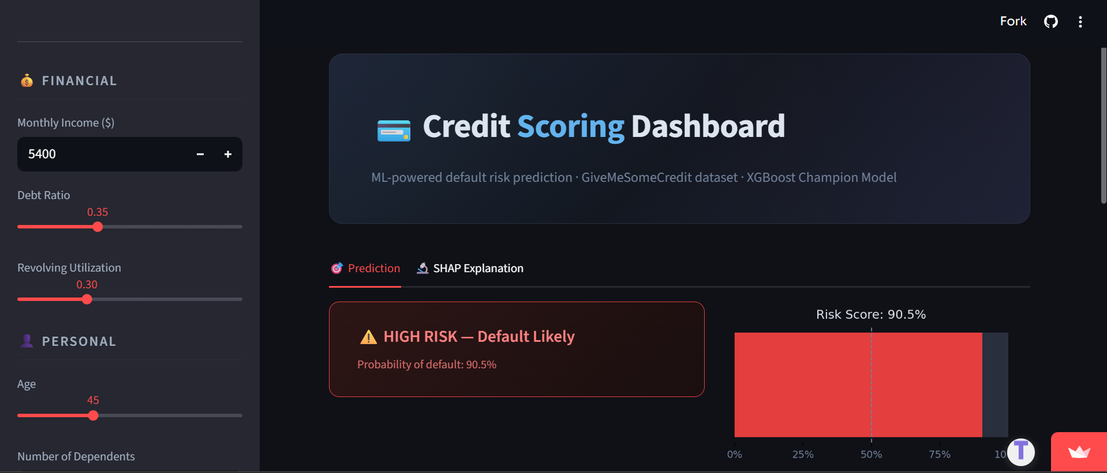
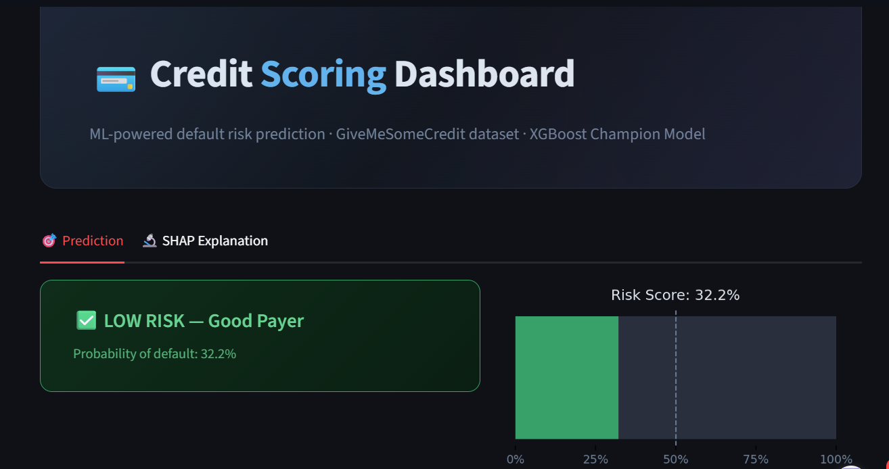
DASHBOARD LINK

Slide 20
We didn’t just predict default risk,
We taught a system
how to make a decision under uncertainty
Because in real life, data is never perfect…
and decisions are never easy
And what we built…
is a system that can handle both

Slide 21

THANK YOU

